Slide 1

Series In Pandas
Nikhil Darokar

Slide 2
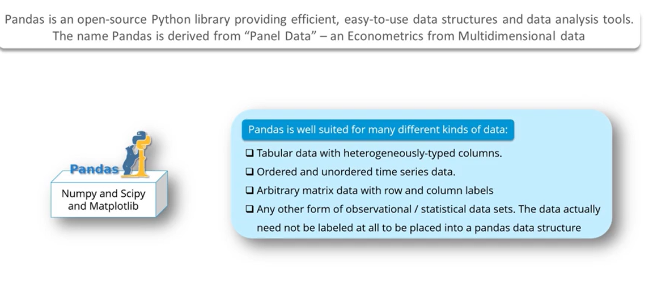

Slide 3
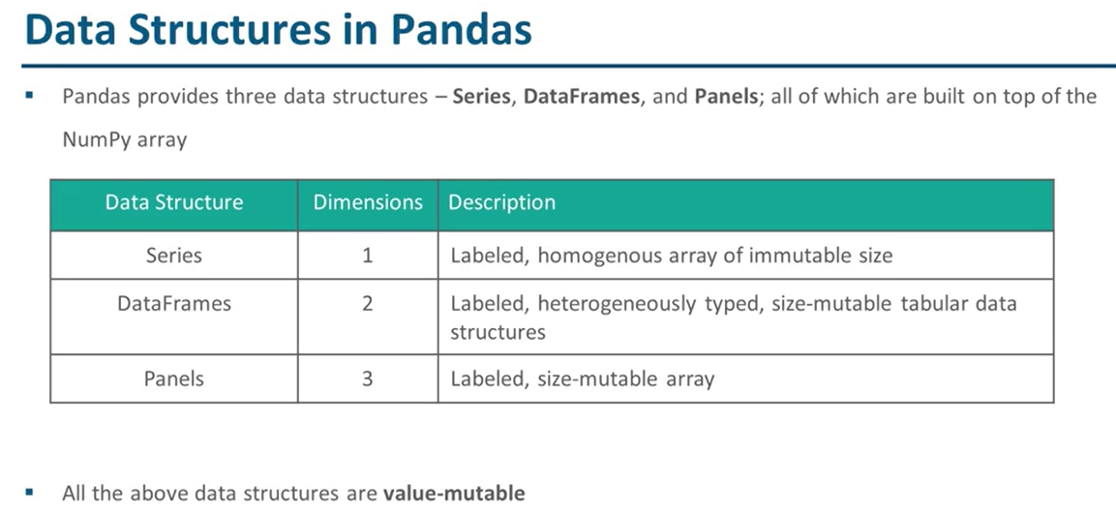

Slide 4
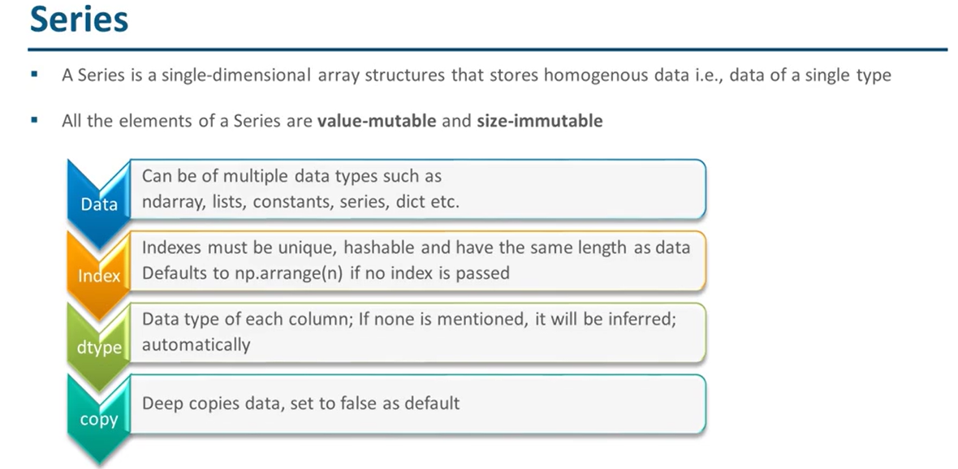

Slide 5
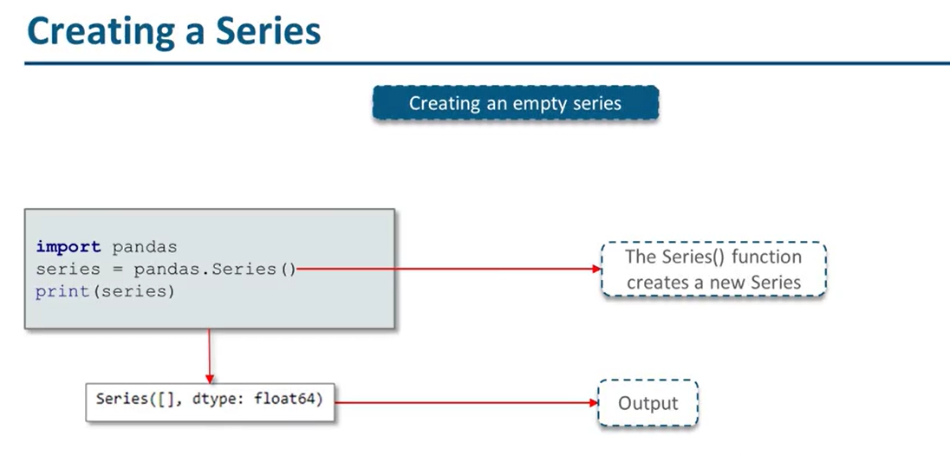

Slide 6
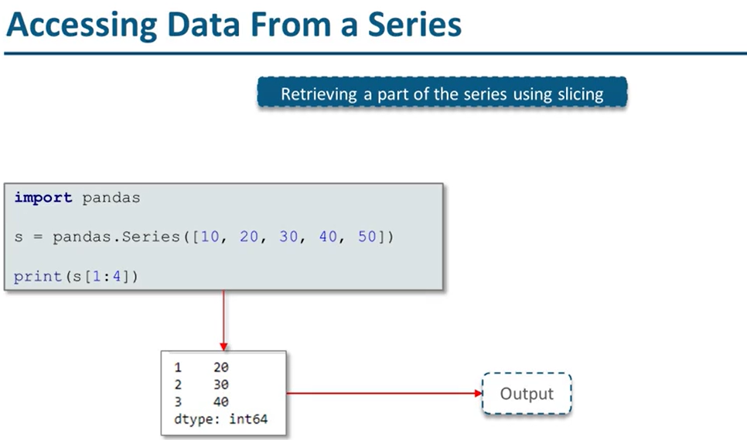

Slide 7
Thank You
Nikhil Darokar

